Slide 1

NLP & Classification of sentiment for Amazon luxury beauty product Reviews
Rawan & Nisreen
Notes:
Line spacing + Page numbers

Slide 2

Agenda
01 Introduction
02 Tools
03 Workflow
04 Data
05 EDA-Analysis
06 Models
07 Conclusion

Slide 3



Introduction
01
In this project, we worked on a dataset which contains amazon luxury beauty product reviews.
The aim of this project is to build an NLP model to find topics for each review. Along the way, we added the sentiment to build a classification model.
Our Goals were:
- Finding a topic for each review .
- Building a classification model to determine the type of sentiment weather its positive or negative.

Slide 4





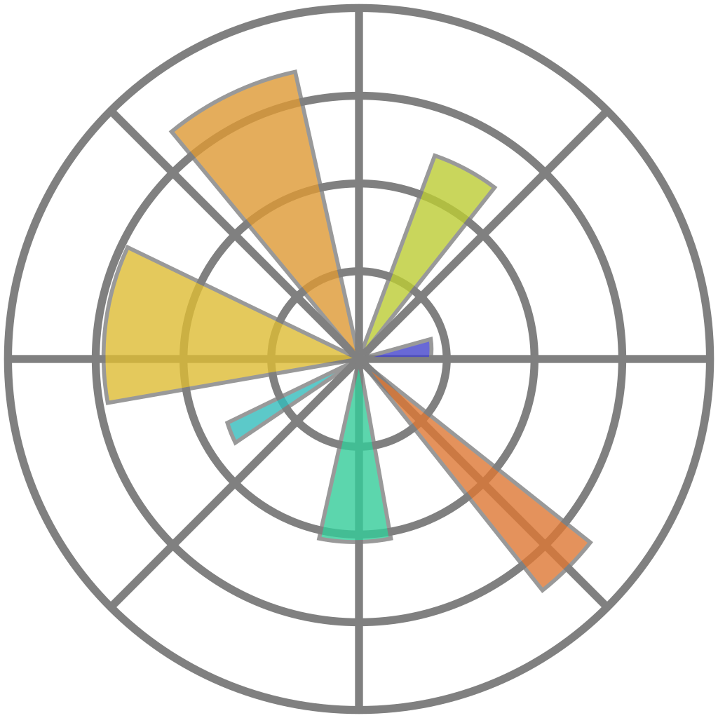

TOOLS:
Numpy
Jupyter
spacy
Seaborn
Pandas
Matplotlib
Scikit-Learn

Slide 5
Workflow
Collecting
Data
EDA
Topics modelling
Classification
Choosing the best Model

Slide 6
EDA and Data Cleaning
The dataset from were obtained from:
https://nijianmo.github.io/amazon/index.html#
The dataset contains:
34278 reviews (rows) ,and 12 columns.
Cleaning Data :
- removing Nulls, Stripping columns name from spaces
- Deleting outliers
- Removing unneeded columns such as: reviewer name, time of the review
- spellcheck
- Lemmatization

Slide 7
EDA and Data Cleaning
- Add A new column for the date, then divided that column into three columns: month, day, and year.
- Adding the sentiment column
- Adding new two columns for the review length and the words counts
- Converting the text using CountVectorizer
also, Converting the text to TfidfVectorizer
Feature Extraction Using svd , variance=.86

Slide 8
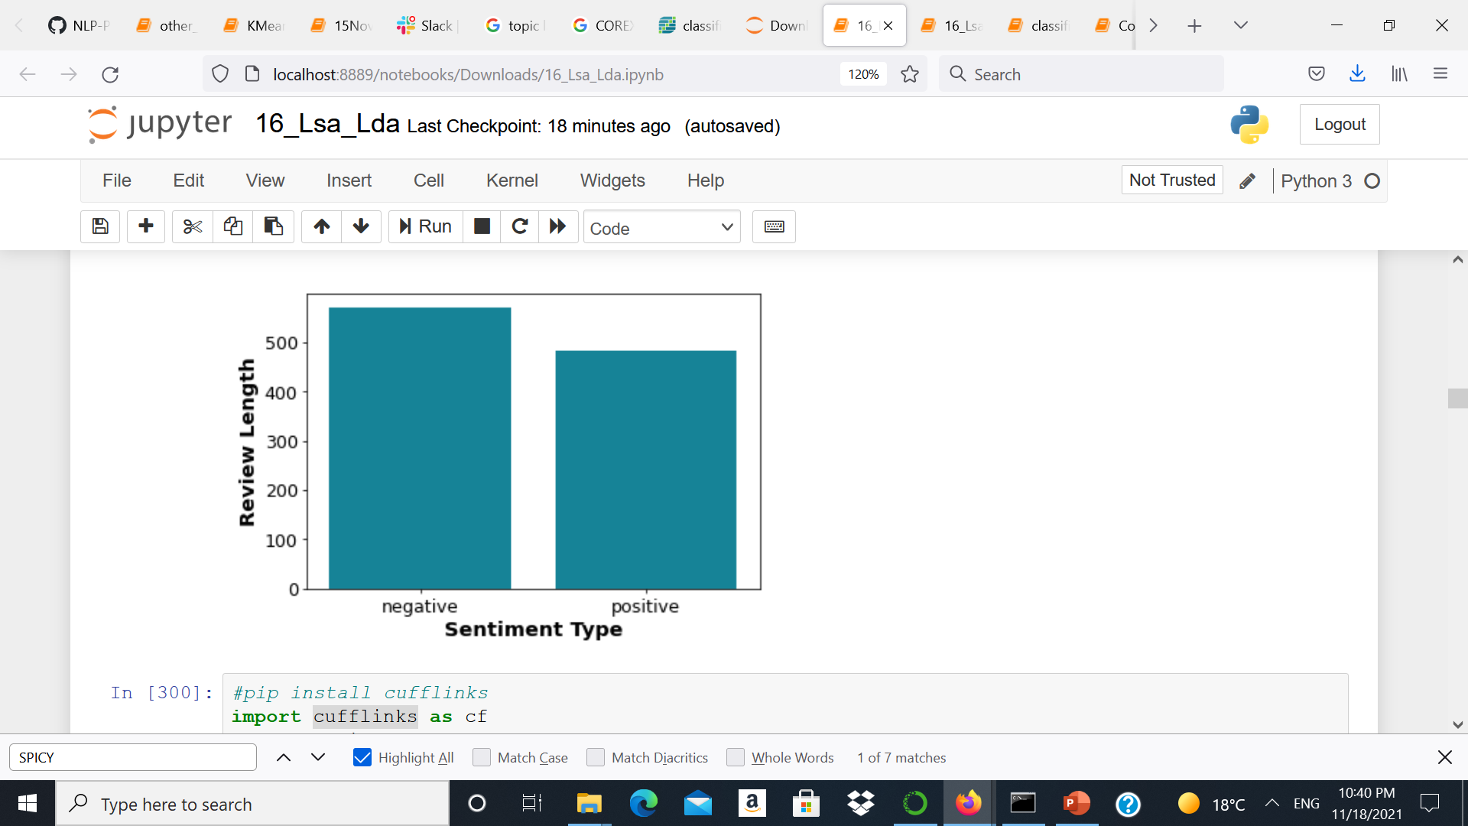
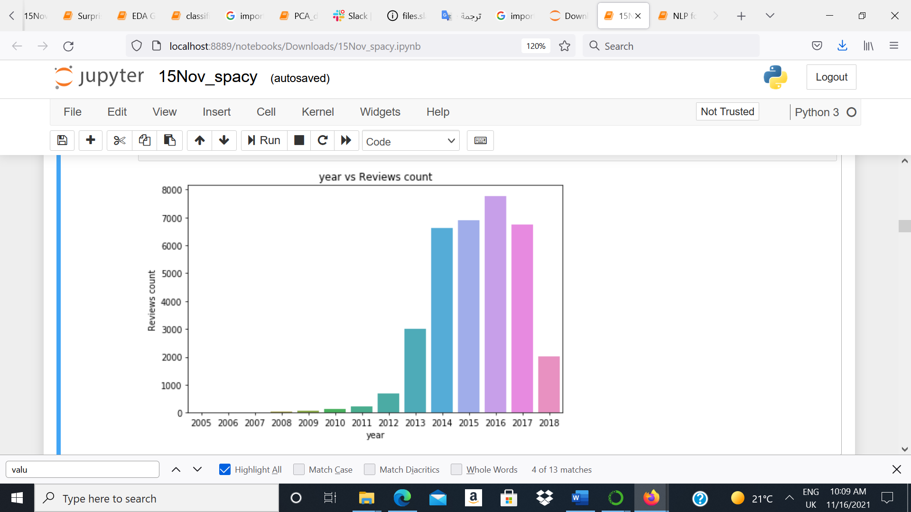
EDA - Analysis

Slide 9
Topics modeling
Frist, we used LSA model to try and find topics from the data, we tried with different numbers of topics from 2 to 10 but were not successful.
then, we used LDA model to try and find topics instead of LSA, we tried with different numbers of topics from 2 to 10 but were not successful.
Finally, we used Corex which gave us some sensible topics, but they were interlinked so much that we had to use anchors to try to force the model to focus on a sensible topics.

Slide 10

Topic modelling:
LSA model
LDA model
Corex Model
Topics:
scent
nail
skin
makeup
delivery
hair

Slide 11
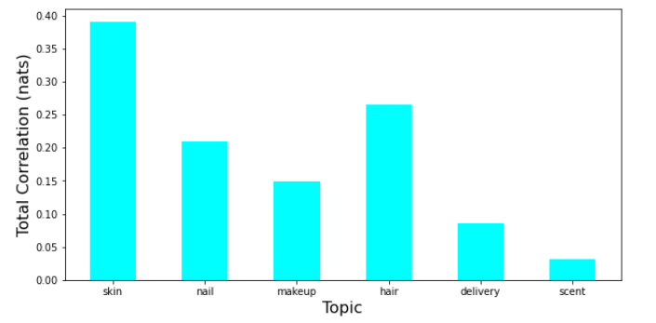
Topic modelling:

Slide 12
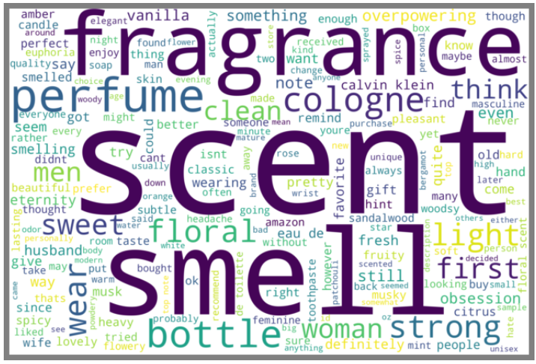
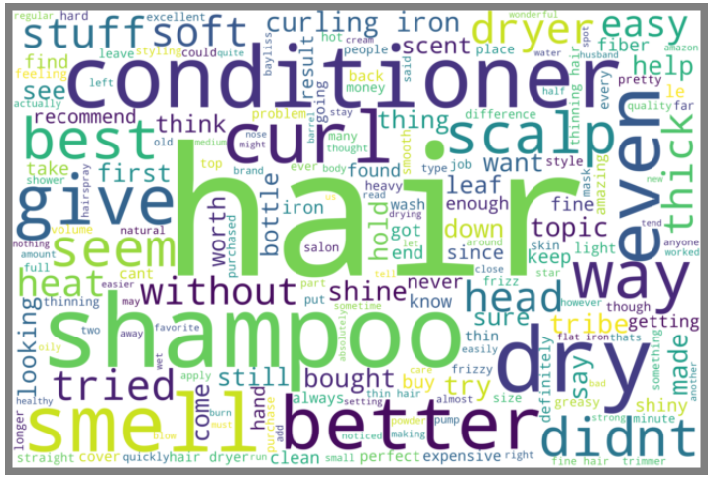
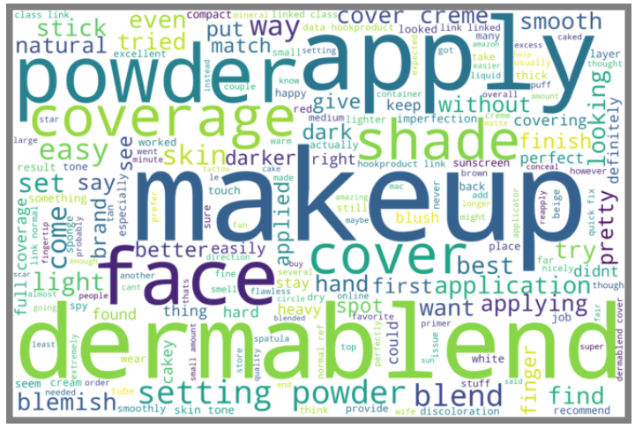
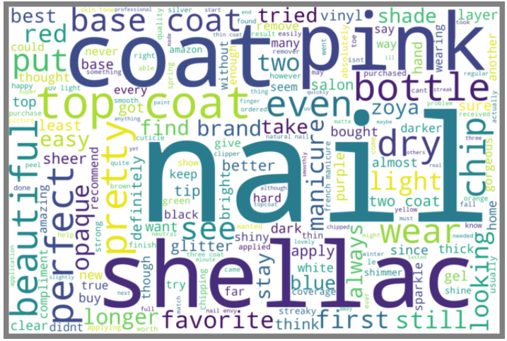
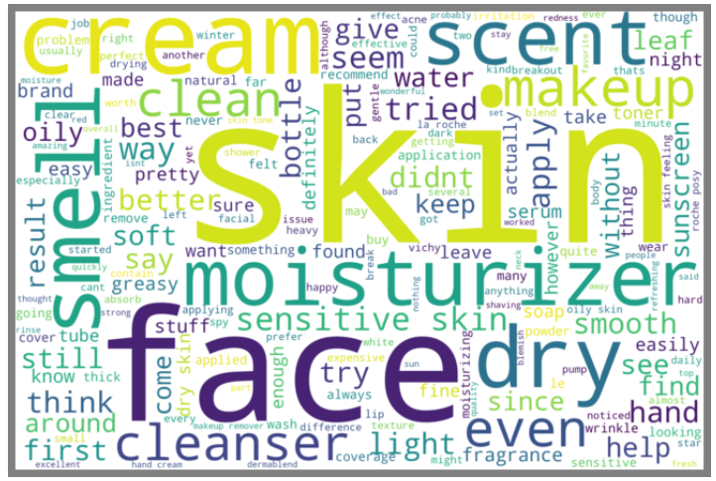
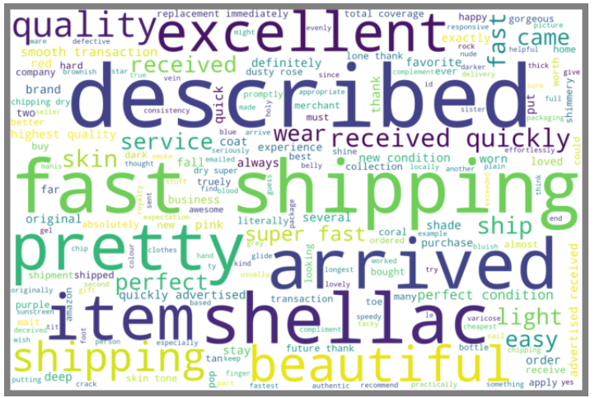
Word cloud for each topic
scent
hair
makeup
nail
skin
delivery

Slide 13
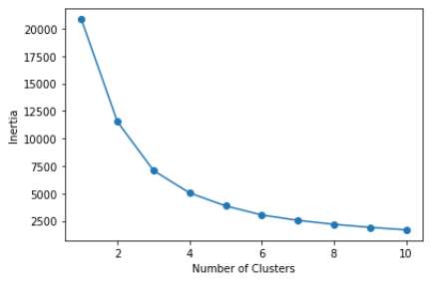
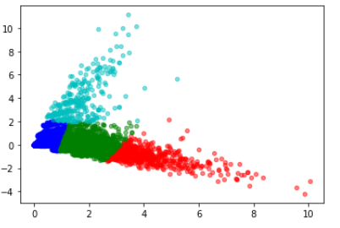
The cluster

Slide 14
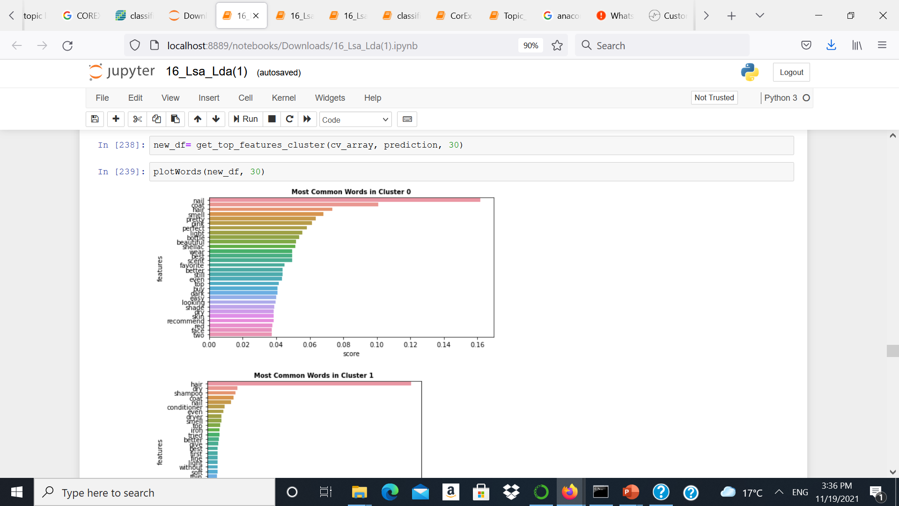
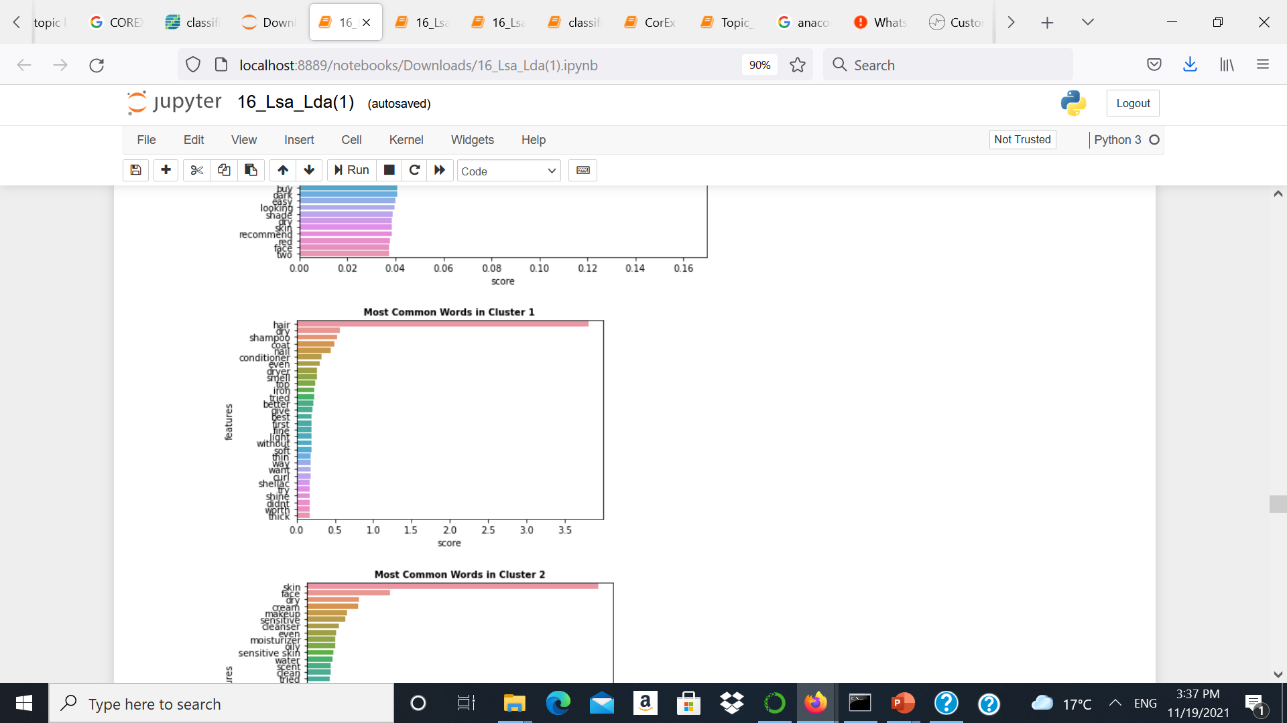
The cluster

Slide 15
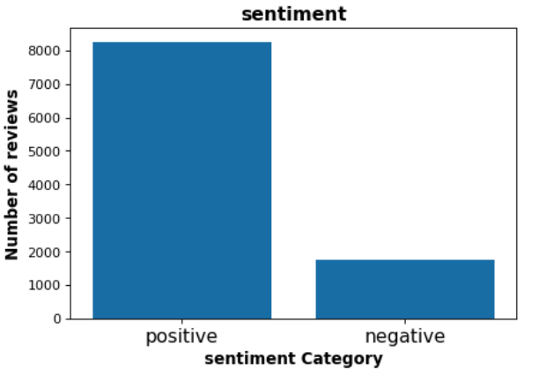
classification
Over sampling
Classification
Classification
Since we are dealing with unbalance dataset we well use f1 score as a matrix

Slide 16
classification
Classification model | F1 score for the validation set
Decision Tree | 88%
Logistic Regression | 92%
Random forest | 92.8%
XGBClassifier | 93%
Training 90%
5% val
5% test
XGBClassifier in test set
F1 score = 93%

Slide 17
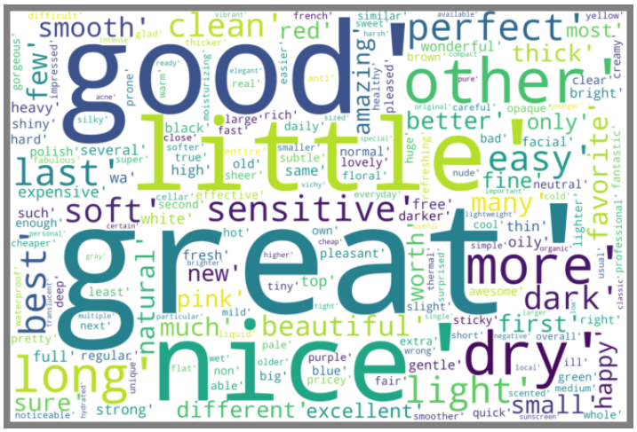
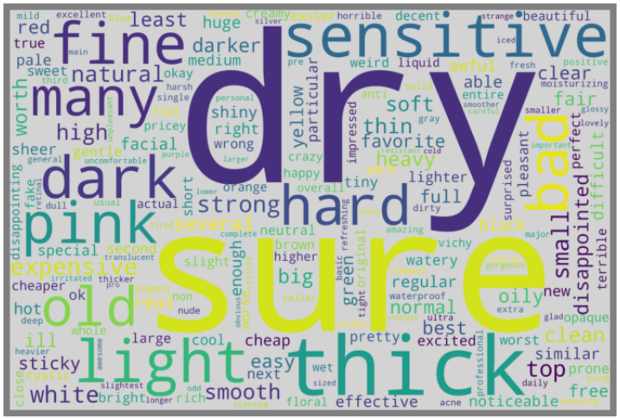
Positive vs. negative reviews
Negative
positive

Slide 18
Conclusion :
Our best topic modeling is Corex
Using over sampling to solve in balance data reduced our f1 score
Our best classifier is XGBClassifier

Slide 19
Future work
collect more reviews for different products.
build a recommendation system for each user .
Try more classifiers .
Build classification model to predict the topic of each review .

Slide 20
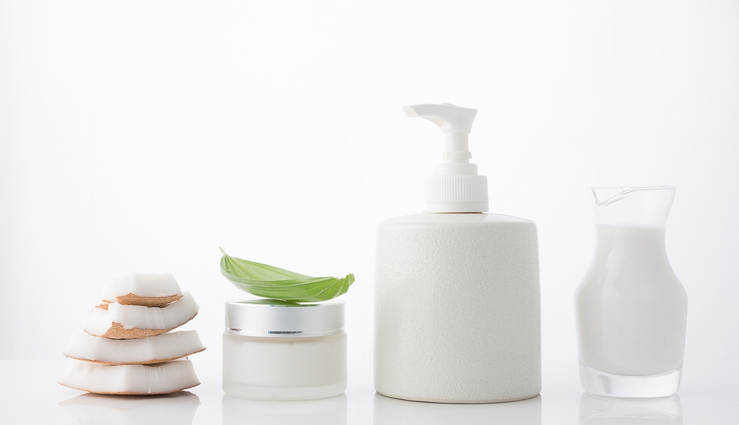
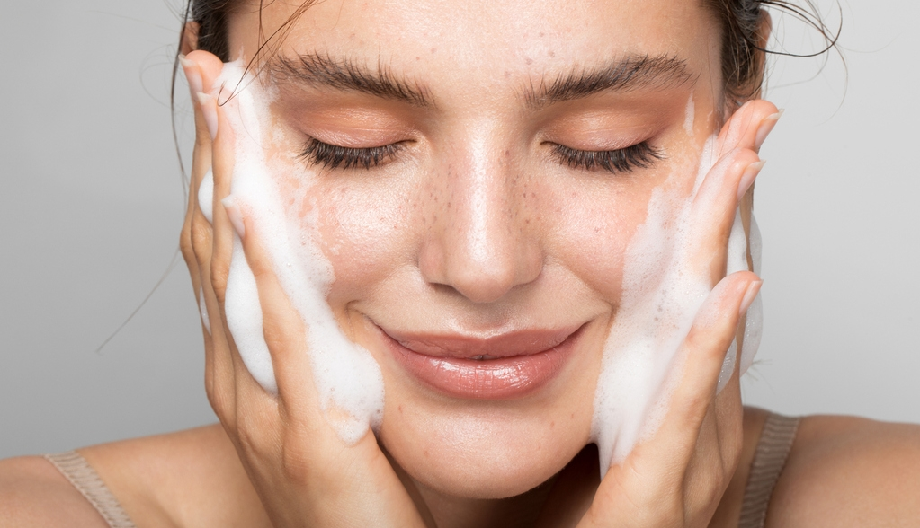
Thank you for listening!

